Slide 1
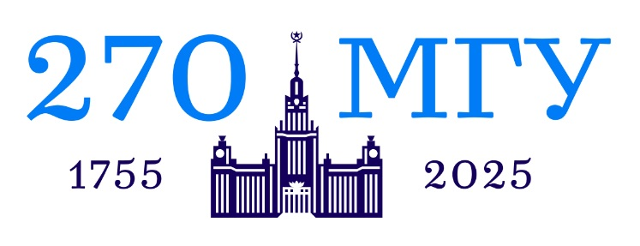
Special considerations for stock trading in the context of the Islamic finance model
4th CIS - Islamic Banking and Finance Forum
June 16, 2025 at Tashkent, Uzbekistan
Magomet Iandiev
Lomonosov Moscow State University

Slide 2
INTRODUCTION
It is a well-known fact that stock exchanges can be speculated on.
The construction of the Islamic (partnership) finance industry has begun in Russia.
Research question: is there speculation on the Moscow Exchange and is it possible to trade on this exchange in light of the requirements of sharia.

Slide 3
LITERATURE REVIEW
1. Metwally, Mokhtar M., The Role of the Stock Exchange in an Islamic Economy (1984). Journal of King Abdulaziz University: Islamic Economics, Vol. 2, No. 1, 1984, Available at SSRN: https://ssrn.com/abstract=3127760/
2. El Gari, Mohamed Ali, Towards an Islamic Stock Market (December 1, 1993). Islamic Economic Studies, Vol. 1, No. 1, 1993, Available at SSRN: https://ssrn.com/abstract=3168367/
3. El-Ashkar, Ahmad Abdel Fattah, Towards an Islamic Stock Exchange in a Transitional Stage (Dec 01, 1995). Islamic Economic Studies, Vol. 3, No. 1, 1995, Available at SSRN: https://ssrn.com/abstract=3166791/
4. Tag el-Din, Seif el-Din, The Stock-Exchange from an Islamic Perspective (1996). Journal of King Abdulaziz University: Islamic Economics, Vol. 8, No. 1, 1996, Available at SSRN: https://ssrn.com/abstract=3074501/
5. Al-Masri, Rafic Yunus, Speculation between Proponents and Opponents (2007). Journal of King Abdulaziz University: Islamic Economics, Vol. 20, No. 1, 2007, Available at SSRN: https://ssrn.com/abstract=3099409/
6. Al-Suhaibani, Mohammad, المضاربة في الأسواق المالية مع الإشارة لحالة سوق الأسهم السعودية (Speculation in Financial Markets with a Reference to the Case of Saudi Stock Market) (June 7, 2009). Available at SSRN: https://ssrn.com/abstract=2275972/

Slide 4
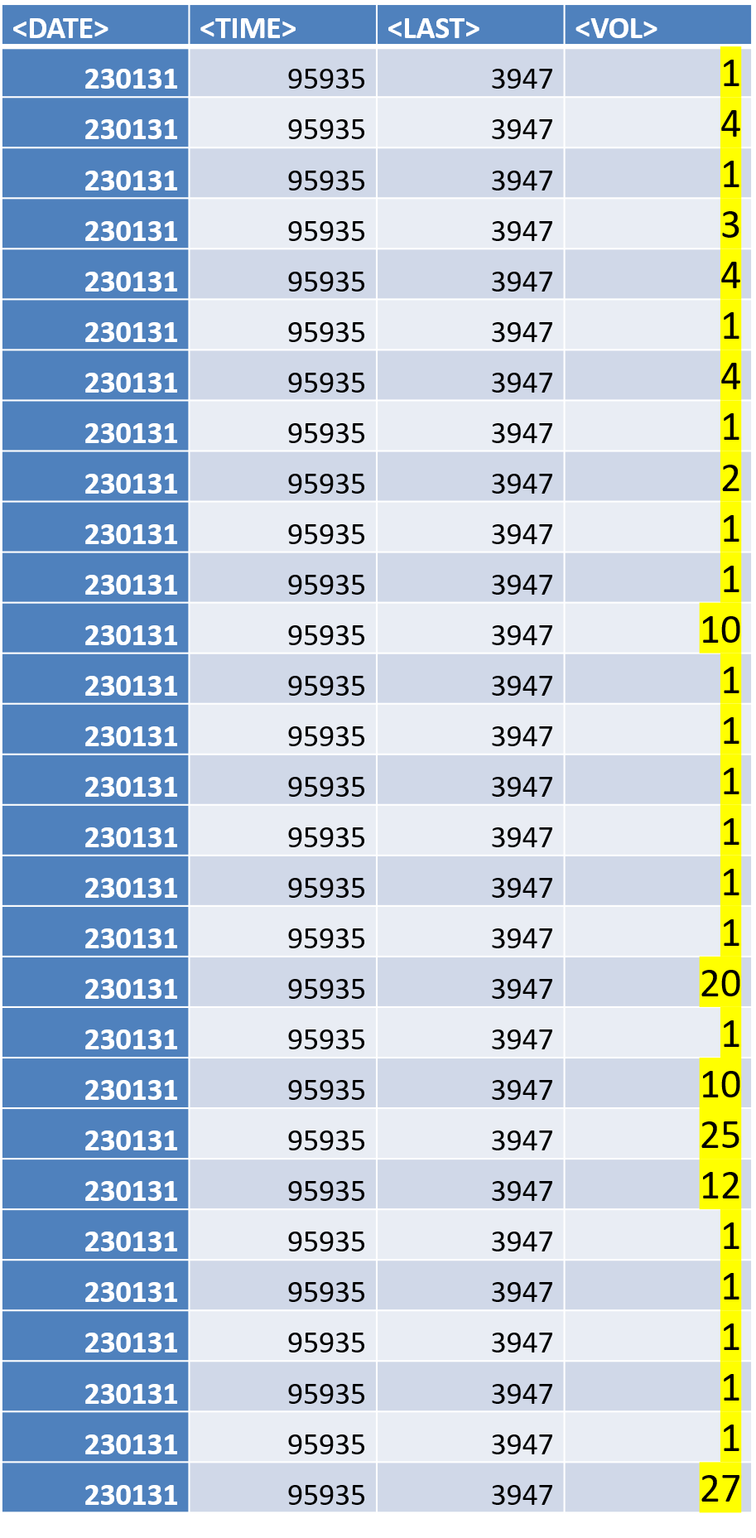
ЛУКойл
31.01.2023 www.finam.ru/

Slide 5
Роснефть January 2023 www.finam.ru/
Author's calculations

Slide 6
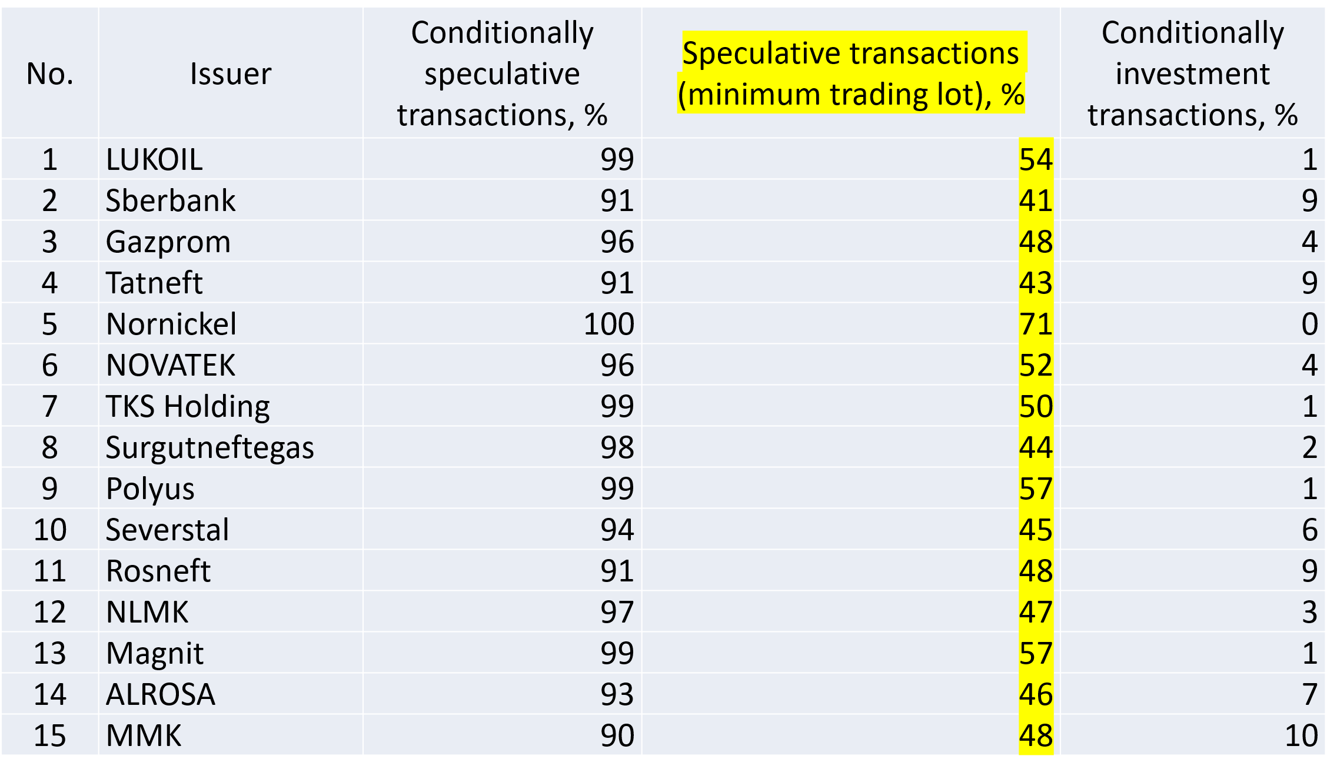
Structure of transactions in blue-chip stocks,
January 2023

Slide 7
The term "speculation" does not have an unambiguously negative perception in society.
Moreover, speculation on the stock exchange is perceived by many as a natural process/activity.
Sharia law directly prohibits speculation in agricultural products, but participants in the securities market believe that this does not apply to them.
speculation is condemned, which consists of purchasing and deliberately holding back goods from sale, in the expectation that they will become more expensive.
Shariah clearly prohibits such a technology.
However, speculation on the stock exchange is not aimed at creating a deficit and is generally represented by a different technology.

Slide 8
STOCK EXCHANGE SPECULATION IS:
concluding numerous transactions for the purchase/sale of securities based on market conditions/prices.
placing/withdrawing orders.

Slide 9
FINDINGS & DISCUSSION
Commentary on Stock Market Speculation:
In Sharia, income obtained through unproductive, useless to society labor cannot be considered permissible.
It is forbidden to sell goods that the seller does not own.
The practice of misleading is unacceptable
It is unacceptable to conclude unequal contracts

Slide 10
CONCLUSIONs
An Islamic investor has no right to speculate.
A modern stock exchange cannot be a place for Islamic investments.
The Islamic financial system needs stock exchanges (a separate section on the Moscow Exchange) that prevent speculative transactions:
-a two-level trading mechanism (like currency trading);
-an increased minimum trading lot.
A new Sharia standard is needed, dedicated to the organization of exchange trading in financial assets (similar to the AAOIFI standard #21).

Slide 11

mag2097@mail.ru
THANK YOU!

